Slide 1
Booting Process
                - Vikram Satpute

Slide 2
Contents
Introduction to Booting.
Booting Steps

Slide 3
What is Booting?
The procedure of starting a computer by loading a kernel is known as booting.
After pressing power button, the motherboard sends a signal to the power supply unit(SMPS).
After receiving power OK signal the computer can boot.
Otherwise, reset signal is sent and computer cannot boot.

Slide 4
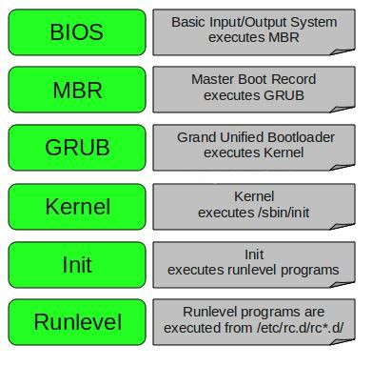
Booting Steps

Slide 5
After CPU receives power OK signal, the CPU resets its registers with a predefined value.
The register value is set with 0xFFFF0000 which is an address location in ROM.
This address location has another instruction which is a jump instruction.
Jump instruction points to BIOS.

Slide 6
BIOS
BIOS is a software stored on a small memory chip on motherboard.
The most important use of BIOS is POST(Power on Self Test).
POST
- Checks and tests the hardware.
The BIOS settings are stored on the CMOS chip.
BIOS looks for boot order in CMOS settings.
After successful completion of POST, BIOS looks for MBR at a permanent location on the harddisk.

Slide 7
MBR(Master Boot Record)
MBR
MBR has two components:
- Bootloader information (446 btyes)
- Partition table information (64 bytes)
Bootloader
(446 bytes)
Partition Table
(64 bytes)
Magic Number(2 bytes)

Slide 8
GRUB (Grand Unified Bootloader)
GRUB is the default bootloader for many linux distributions.
The desired Operating System can be selected from the grub menu.
GRUB requires the harddisk number, partition number and the filename of kernel.
GRUB loads the kernel and initrd.

Slide 9
GRUB Configuration file
default=0
timeout=5
splashimage=(hd0,0)/grub/splash.xpm.gz
hiddenmenu
title CentOS (2.6.18-238.12.1.el5)
root (hd0,0)
kernel /vmlinuz-2.6.18-238.12.1.el5 ro root=LABEL=/ rhgb rhgb quiet
initrd /initrd-2.6.18-238.12.1.el5.img

Slide 10
Kernel
Kernel is present in RAM until the system shutdown.
It communicates with hardware and manages resources such as RAM and CPU.
Kernel executes init process.

Slide 11
Init
Init is the first process executed by kernel.
PID of init is 1.
Init is the parent of all processes and is responsible for starting other processes.
Init loads all the programs from the default runlevel.
/etc/inittab file contains the default runlevel.
runlevel command can be used to check the default runlevel.

Slide 12
Runlevels
0. System Shutdown
1. Single User Mode
2. Multiuser mode without networking
3. Multiuser mode with networking
4. Not used
5. Multiuser mode + Display Manager(GUI)
6. Reboot
Runlevel programs can be found in the directories /etc/rc.d/rc*.d/
The processes are associated with two flags:
- K(Kill)
- S(Start)

